Slide 1
Investigative Findings of the 1979 Mill Woods Incident Melissa Ladd, Emergency Response Coordinator, Emergency Management Presentation to EAPUOC
April 16, 2019

Slide 2
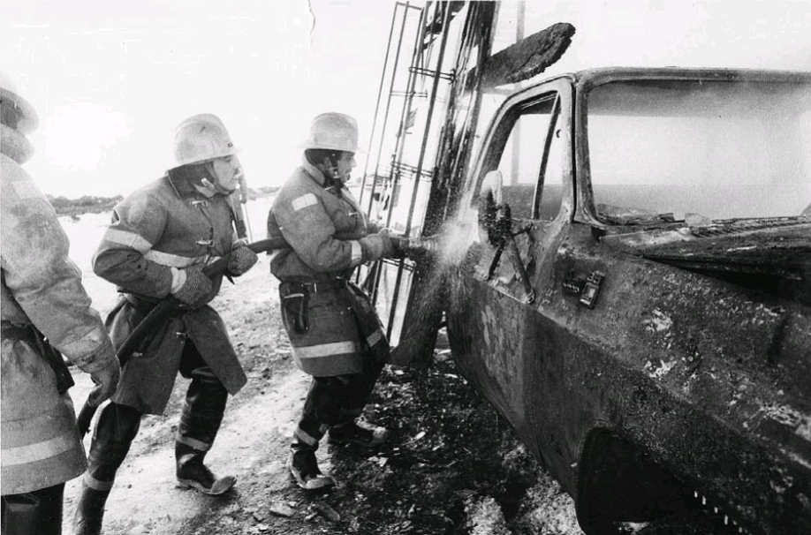
Friday March 2, 1979
Notes:
The morning of Friday March 2, 1979 a 219mm diameter pipeline ruptured in the Mill Woods area. Liquid propane was released with 7600kPa of pressure, this formed a cloud of propane vapour and travelled Northward.
The pipeline rupture also resulted in the formation of a pond of liquid propane. At approximately noon, a commercial vehicle entered the drifting vapour and ignited. The ignition resulted in serve injuries to the driver, Mr. Peter Clark.
The propane travelled into adjacent storm sewers, spreading through the sewer lines and eventually resulted in the evacuation of 19,000 residents from their homes.
It was determined the cause of the leak was the result of an excavator damaging a pipeline.

Slide 3
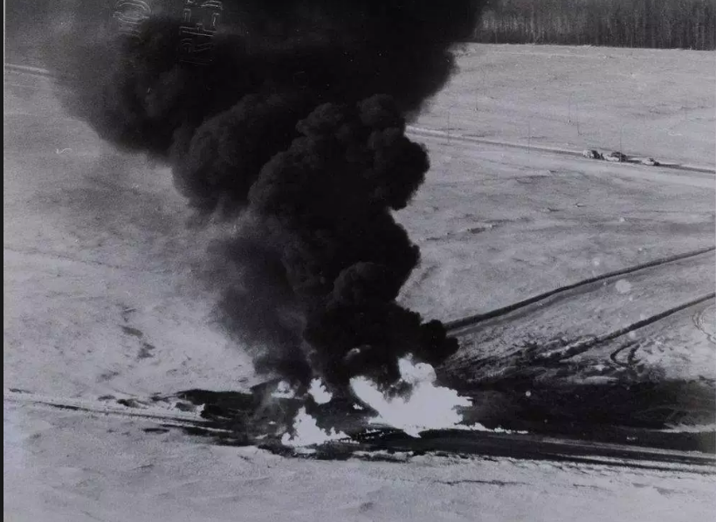
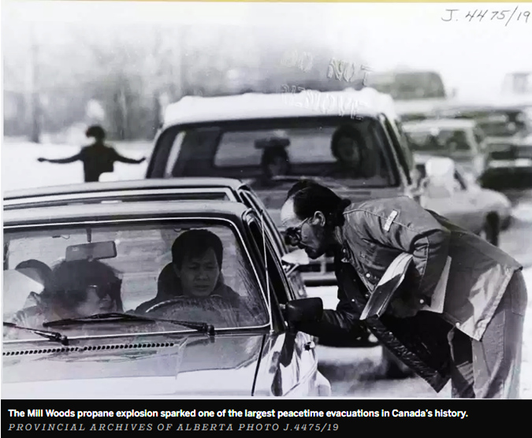
The Response
Notes:
The mass evacuation of residents was conducted by the City of Edmonton Fire Department and Police Department in collaboration with the City of Edmonton’s Disaster services agency.
They used A combination of flushing the lines with water and the use of nitrogen blanketing eliminate the danger to residents. The use of nitrogen was used as it was lighter than propane, and heavier than air, this was to prevent the propane gas from rising in to the houses through the sewer system
Once this had all be completed they were given the “all clear” to return to their homes at 10:45am on March 3, 1979 (23hrs later).

Slide 4
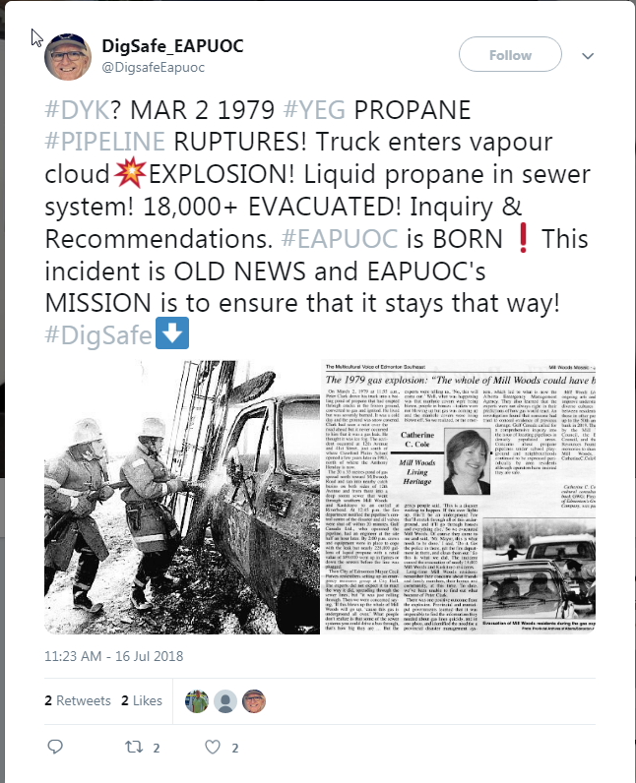
ERBC Recommendations
Control of Activities Over Pipelines
Pipeline Integrity & Public Safety
Pipeline Planning in Urban Areas
Contingency Planning & Emergency Equipment
Notes:
The after action review from the ERCB came up with 14 findings and 15 recommendations. I can’t go through all of these in my allotted time; however, I have pulled them into four areas to focus on.
Control of Activities Over Pipelines
Pipeline Integrity & Public Safety
Pipeline Planning in Urban Areas
Contingency Planning & Emergency Equipment

Slide 5
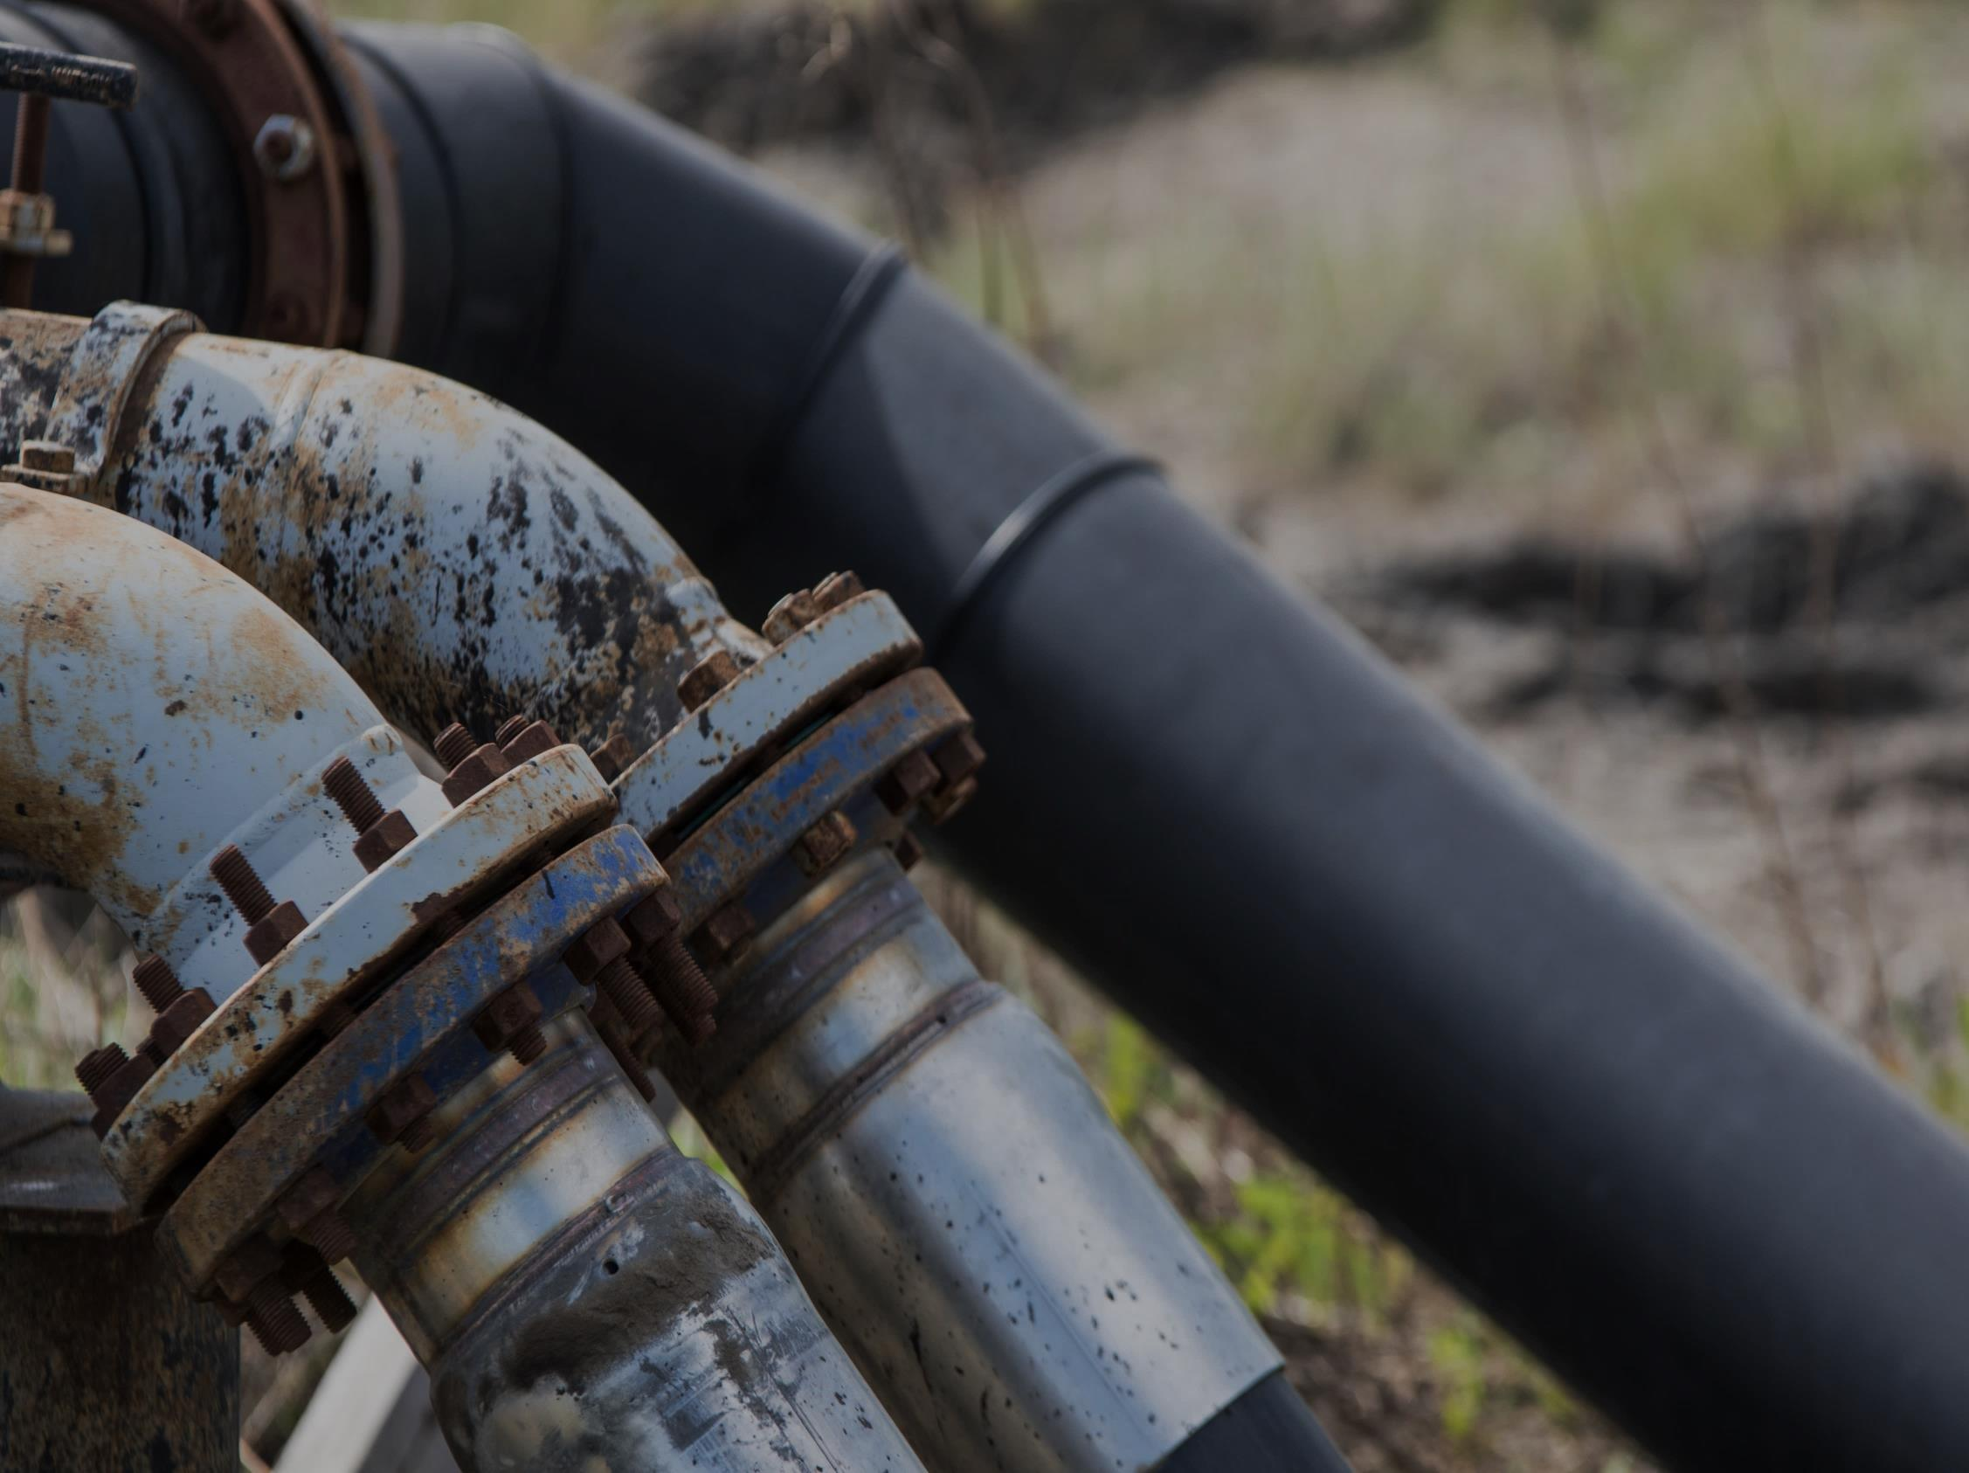
Control of Activities Over Pipelines
Rupture was due to external damage on the line
Damage would have been found with adequate information during construction
Alberta One Call
Notes:
FINDINGS
Previous construction activities were conducted in the Spring and Fall of 1978 which compromised the integrity of the line. The rupture of the Rimbey pipeline at the 12th Ave was the result of external damage (5.1)
It was also noted, under normal operating procedures, had the line not been damaged, it likely would not have failed (5.2)
And external damage would have been found with adequate inspection/supervision during construction activities (5.4)
And finally, the pipeline company and contractor have a continuing mutual responsibility before, during, and after a crossing is completed (5.4)
RECOMMENDATION 6.6 –
From this the recommendation for Pipeline companies and construction contractors to exercise control of surface activities over pipelines to prevent or reduce damage to existing lines.
And from this Alberta One call was created in 1984 to provide a communication service, between the digging community and the owners of buried facilities, to ensure the known location before any ground disturbance.

Slide 6
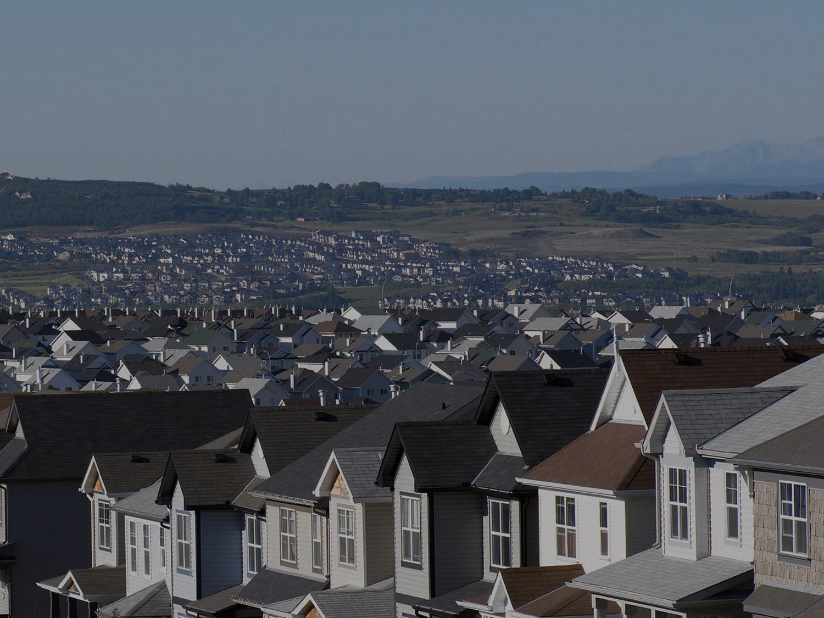
Pipeline Integrity & Public Safety
Land use planning
Upgrade to current requirements outlined by Canadian Standards Association
Emergency Response Plans
Inspections
Notes:
FINDINGS
To reduce risk and attempt to eliminate the hazard to the public, a recommendation for a minimum distance between buildings, hazardous products, pipelines, and selective use urban planning was suggested. (5.7)
It was also suggested that to upgrades to current zoning requirements, operating pressures, and the use of of block values should be implemented.
RECOMMENDATIONS
The city of Edmonton should establish an overall contingency plan that is capable of handling pipeline emergencies of all types, this has also expanded beyond oil and gas emergencies to date. (6.13 )
Upgrade to current CSA requirements for pipeline transportation systems of liquid petroleum in urban areas through pipelines.
(6.11 )
So what do we have now? Emergency Reponses plans are required of every producer, they must take into account the residents in communities within their Emergency Planning Zone. These plans are reviewed and audited by the EM team at the AER to ensure they adhere to directive 71 recommendations.
ERPs are not limited to just pipelines but also oil and gas facilities.
Routine Inspections at the field level to ensure lines are not compromised.
PREPARDNESS/Mitigation

Slide 7
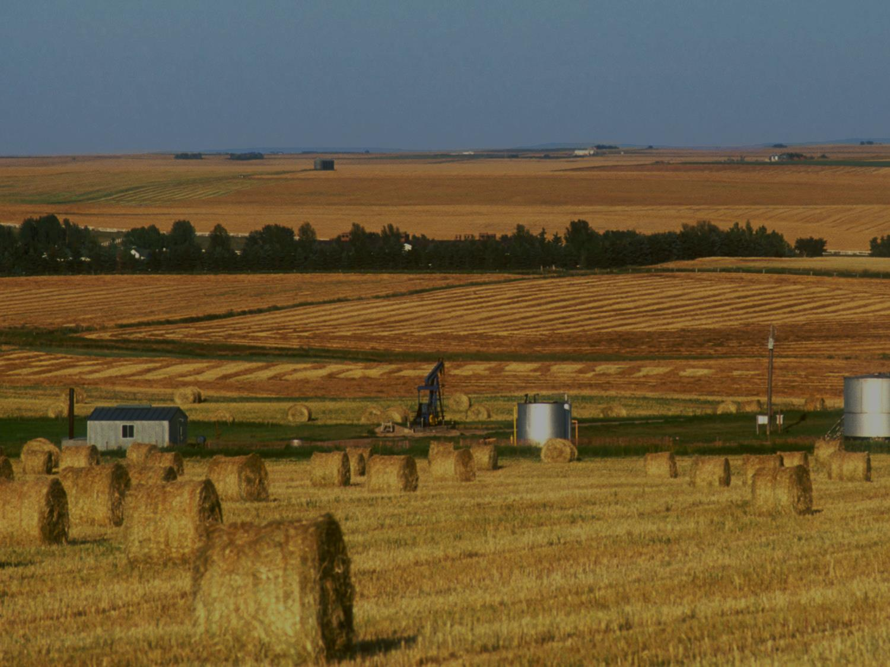
Pipeline Planning in Urban Areas
Adhere to up to date standards
All pipeline companies verify the status of their lines
Future city planning and existing pipelines
Notes:
What was here first?
FINDINGS
The Rimbey pipeline was constructed in 1961 and at the time was mostly under Edmonton area farmland so again CSA standard of these lines were built to the requirements at the time, and were no longer deemed appropriate for carrying liquid propane through urban areas (5.9)
In addition to this, all pipeline companies operating in the Mill Woods area should meet with a board of representatives to review their pipeline status and operations to avoid a similar failure (5.15)
RECOMMENDATION
A minimum distance from hazardous product pipelines needs to be in place, to reduce the risk of the external damage and minimize the hazard to the public and surrounding structures. (6.9)
It is important for Future city planning to know what was here first and how to ensure public safety with urban sprawl.

Slide 8
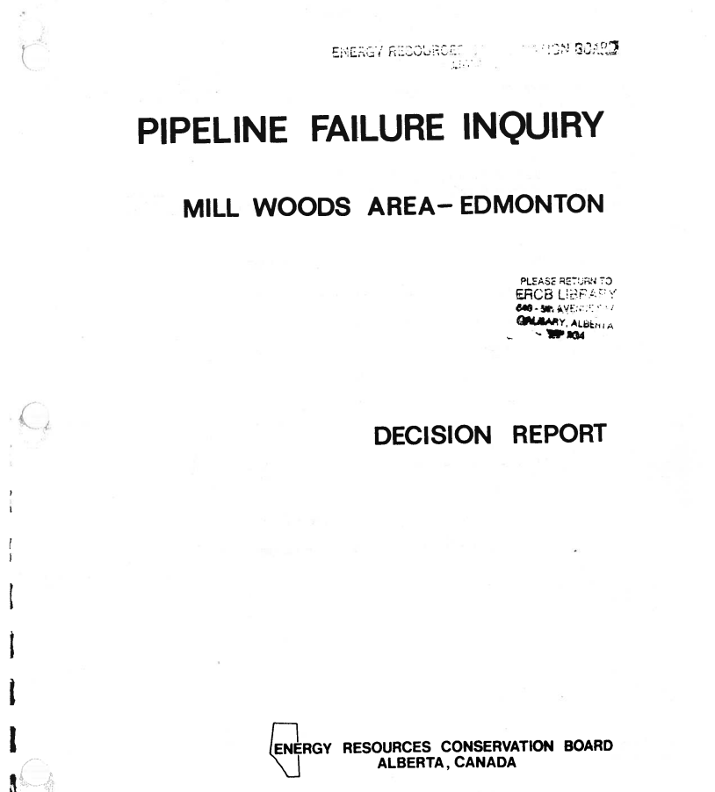
Contingency Planning &
Emergency Equipment
City Emergency Response Plans
Specialized Resources
Notes:
Contingency Planning & Emergency Equipment
FINDINGS
At the time no contingency plan was available in the City of Edmonton for pipeline emergencies.
It was recommended the city should sponsor an information centre for transport of hazardous materials. There was a need for a working relationship between the City and operators of pipelines similar to the one in place between the City and Nothwestern Ultities at the time (5.11)
Secondly, there was a lack of readily available equipment to stop the release.
RECOMMENDATION 6.13
The City of Edmonton Establish and overall contingency plan capable of handling pipeline emergencies of all types.
City Emergency Response Plans
Specialized Resources in the area to response to pipeline releases

Slide 9
Mutual Aid
Transportation
Notification to impacted residents
Security and patrol
Temporary Shelters
Notes:
We have all of these recommendations but WHAT WENT WELL?
Mutual aid is an agreement to lend assistance. This may be across jurisdictional boundaries within emergency services, it can be between companies or service providers, etc. This may occur due to an emergency response that exceeds local resources. Mutual aid may be ad hoc and requested only when an emergency occurs or it may be in place prior to the event occurring.
RECOMMENDATION: (5.13)
To further improve the efficient ad hoc evacuation and the advantages of “on the spot” coordination in respect to an emergency
At the time was noted as one of the largest residential evacuations in Canada. In addition to this, despite the potential threat to the public, there were no fatalities.
This was a result of the coordination of:
City of Edmonton – Disaster Services Agency
Edmonton Fire Department
Edmonton Police Department
Transportation of residents out of the area
Mass notification - door to door to clear houses
Additional security for the evacuee’s house until the incident was stood down
The creation of temporary shelters for residents that did not have anywhere else to go

Slide 10
EAPOUC’s Application of Emergency Management
Prevention & Mitigation
Preparedness
Alberta One Call
City Planning
CSA Requirements
Pipeline Inspections
Residential and City Emergency Response Plans
Emergency Management
Recovery
Response
Mutual Aid
Trained Personnel
Specialized Equipment
Technical Specialists
Notes:
The 4 pillars of Emergency Management
Prevention/mitigation
associated with efforts is to reduce risk
Preparedness
is to have an effective and coordinated approach to EM and operational readiness.
Response
Deals with the changing threats, hazards, or incidents and have to an effective and integrated approach to establish priorities.
Recovery
this component of EM is to provide for the restoration and continuity of critical services and operations.
Control of Activities Over Pipelines – P&M – Alberta one call
Pipeline Planning in Urban Areas – P&M – Zone planning, CSA Standards
Pipeline Integrity & Public Safety – Preparedness - ERPs
Contingency Planning & Emergency Equipment - Response/Recovery – mutual aid, WCSS

Slide 11
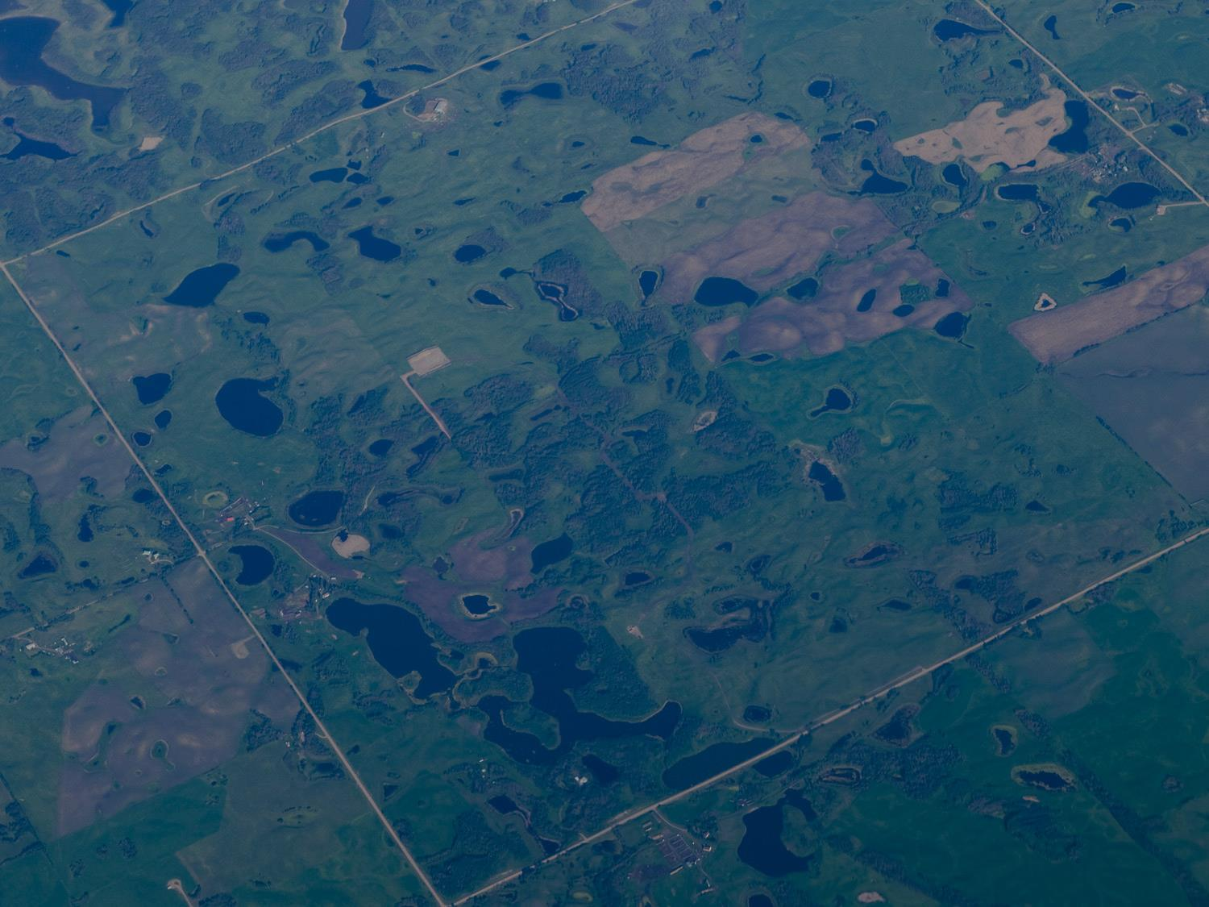
Roles at the Alberta Energy Regulator
Field Inspectors
Duty Officers
Emergency Response Coordinators
Emergency Preparedness Assessors
Notes:
So to bring this back to response at the AER and what we have learned from the Mill Woods incident. The AER applies these same principles of emergency management to all industry related incidents in the province.
In respect to emergency management as well as daily operations we have the following individuals at the AER.
On Call Field Inspector – Approximately 80 – they are distributed throughout 10 field centres
Emergency Competency Assessment (Is industry doing what they should be doing?)
Technical Operations (provide practical direction/advice)
Site Control / Compliance assessment (Regulate)
Deploy (Be the first eyes on the site)
Support the Emergency Triage (have conversation and participate in a decision on deployment)
Duty Officer (DO)
Review initial triage
Communicate with Field inspector (ensure conversation occurs and participate in a decision on deployment)
Dispatch ERC
Communication Support (Build Media, Briefing Notes, Situation reports, Executive Notifications)
Emergency Response Coordinator (ERC) -
ICS Structure Management (Advice on appropriate AER or industry command structure)
Communications Support (Build: Media, BN, Sitreps, Executive Notifications)
Advise on Emergency response techniques (Specialists)
Order (Advisor to ECC Director on plans required and techniques)
D71 requirements (Regulate)
Emergency Preparedness Assessors
receive and approve submitted ERPs
Audits ERPs for compliance with Directive 71
May be involved during an incident by auditing a company’s response (and how it coordinated with the ERP)
Answers inquiries to the EPAhelpline@aer.ca

Slide 12
Incident Notification
Industry or Public Reports
(1-800-222-6514) Hotline
Initial Triage Occurs
Report is Passed to Duty Officer and Validated
Response Occurs
Notes:
So how does this work?
One central call center – EDGE receives complaints, notifications, and emergency calls throughout the Province. The calls are then triaged and based on the set criteria and determines the lead agency.
There are approximately 80 Field Inspectors with the AER, and 5 emergency response coordinators. There is one inspector from each of the 10 Field Centres on call every week, and one emergency response coordinator acts as the on call Duty Officer
If a call to the EDGE is triaged as a complaint or non-emergency incident, it is sent to the on call field inspector.
If the call is triaged as an emergency, it is sent to the Duty Officer.
If the emergency warrants, the AER Duty Officer will deploy an Emergency Response Coordinator to the site, and an ECC is usually stood up to deal with the emergency. (Usually based in the applicable Field Centre and operated by the Field Centre manager).
The Emergency Response Coordinator leads the coordination of AER responses during energy-related incidents.
We are typically engaged in more serious and prolonged incidents, work collaboratively with the local Field Centre(s), provide additional support for any incident if required and will act as the LEAD Agency for energy-related incidents

Slide 13
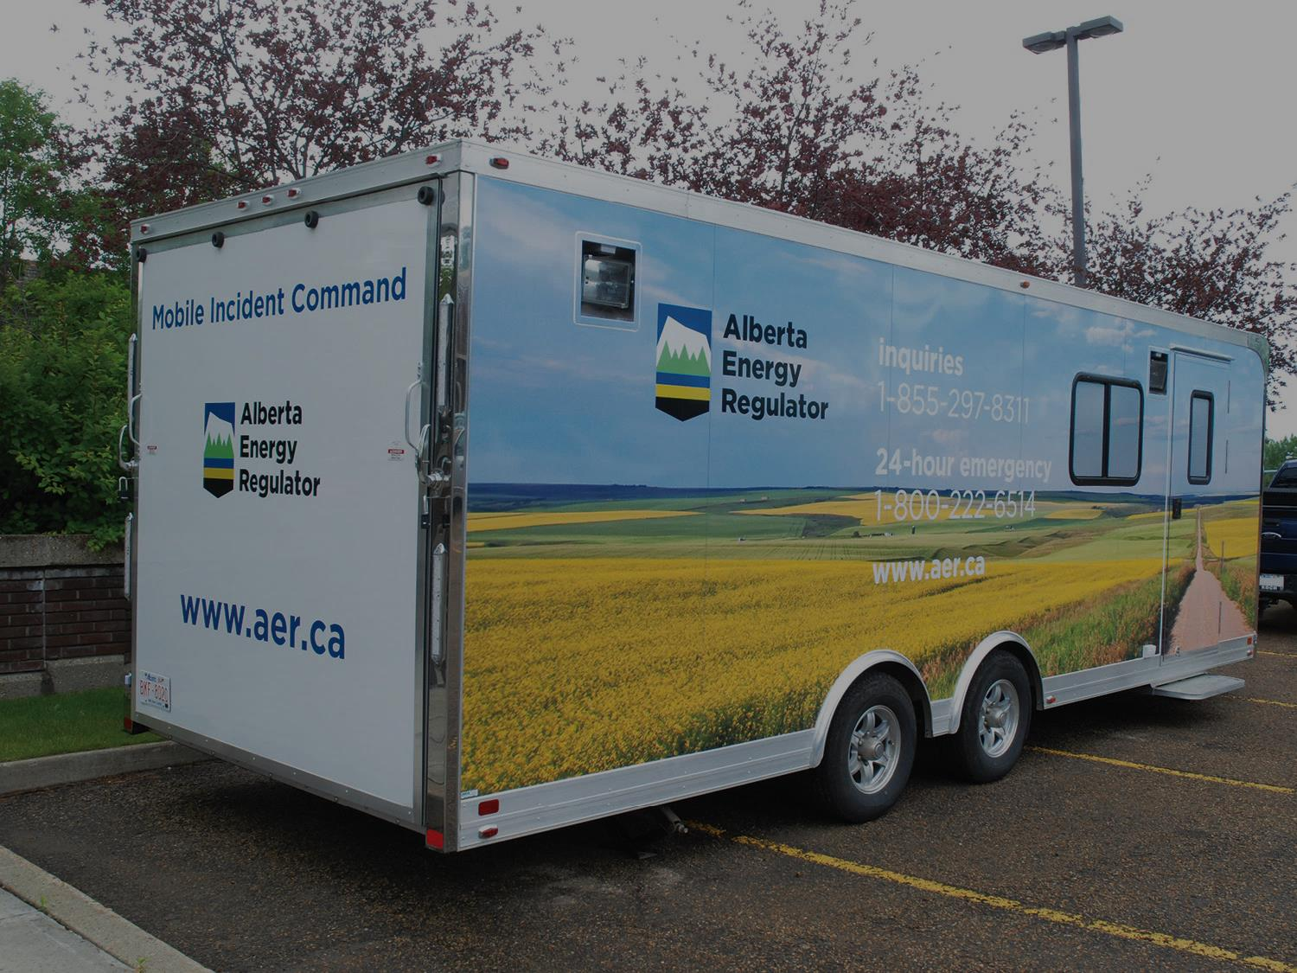
2017 Statistics:
7000 notifications
47 small scale incidents
1 large scale emergency
Notes:
To give you an idea, these are the 2017 stats at the AER across the province.
As with all emergencies, the primary focus is the protection of the public (life safety), environment, and economy.

Slide 14
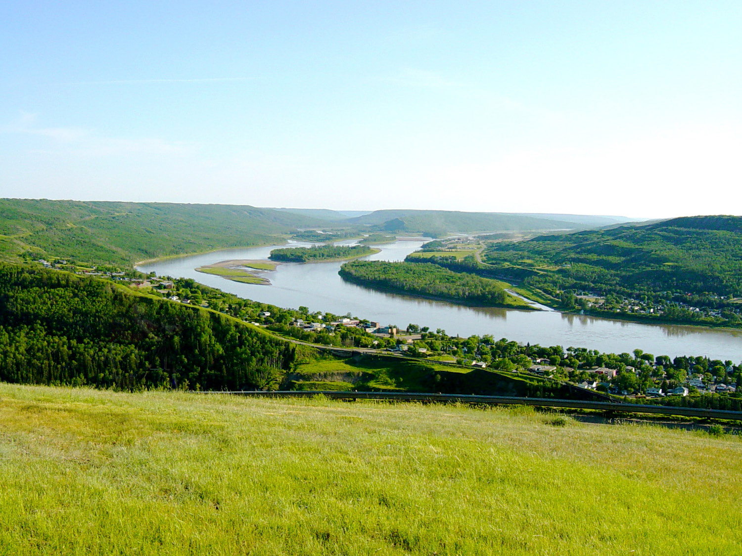
1-800-222-6514
EPAhelpline@aer.ca
Notes:
The creation of and implementation of EAPOUC has come a long way since the Mill Woods Explosion which has assisted in creating incident awareness throughout the province, not just limited to oil and gas activities.
To continue to reduce large scale events impacting the public, our environment, and economy we must ensure that we are all doing out part.
- This includes Emergency prevention, Mitigation, and preparedness
-we need to ensure timely incident reporting which will lead to
-Efficient Response
-Effective and Responsible Recovery

Slide 15
Thank you!

